Slide 1
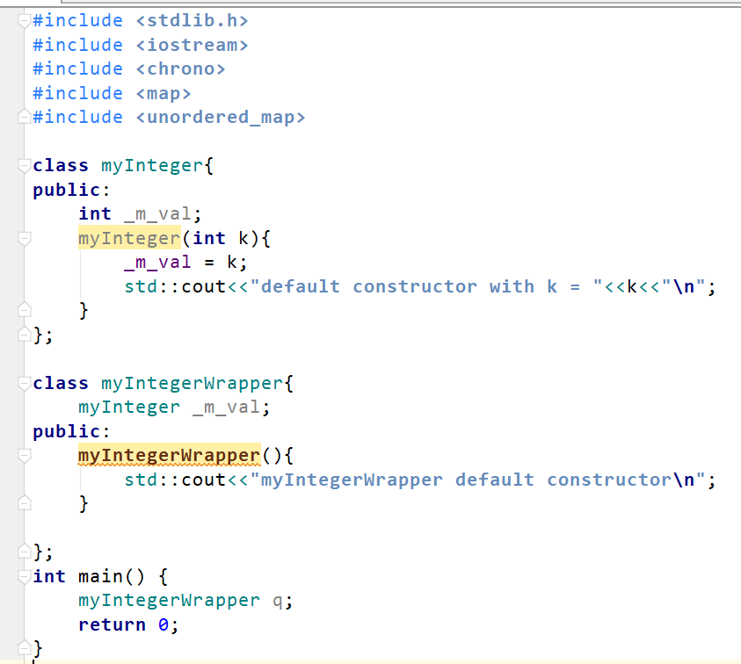

Slide 2
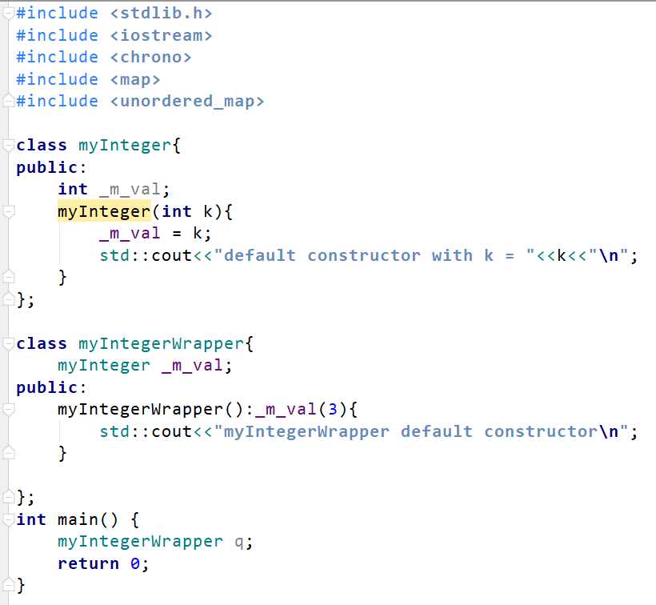

Slide 3
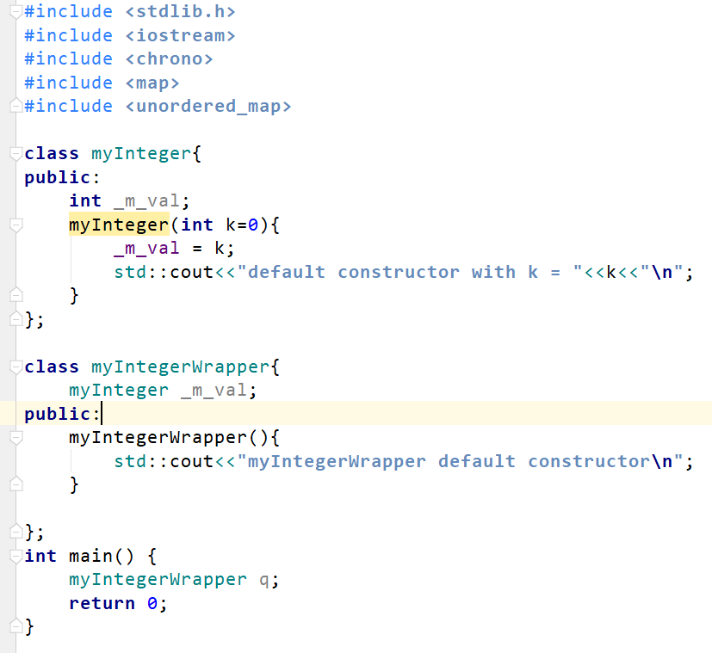

Slide 4
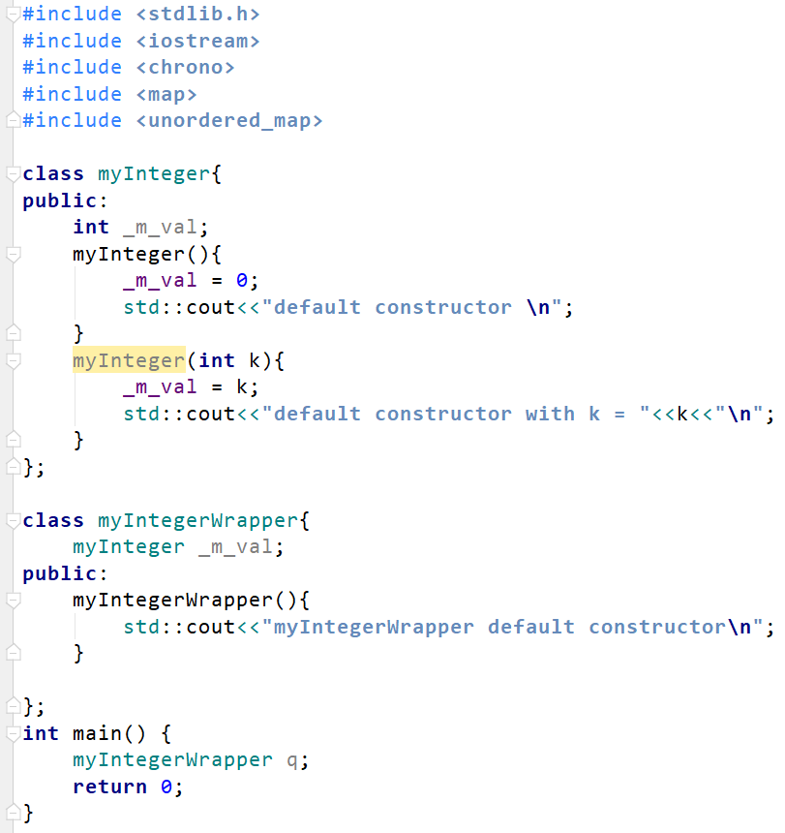

Slide 5
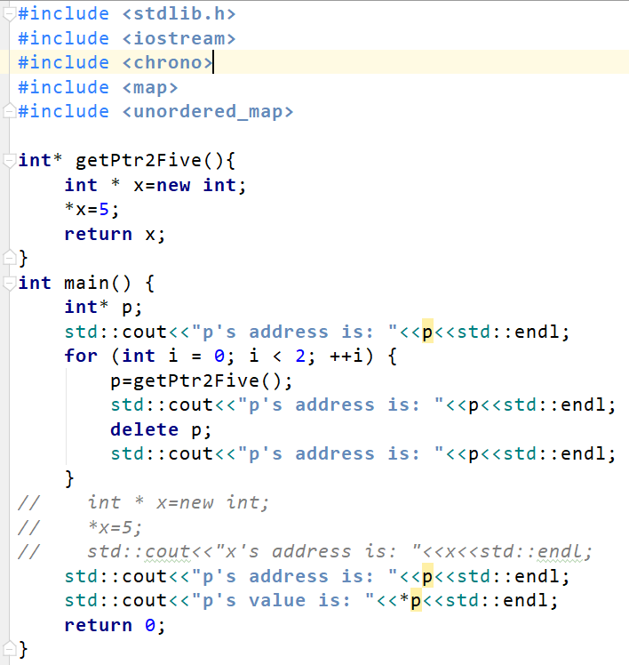
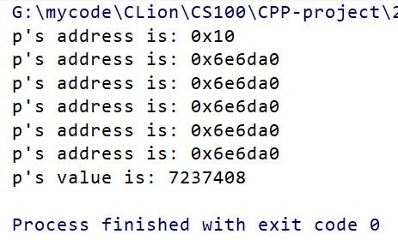

Slide 6
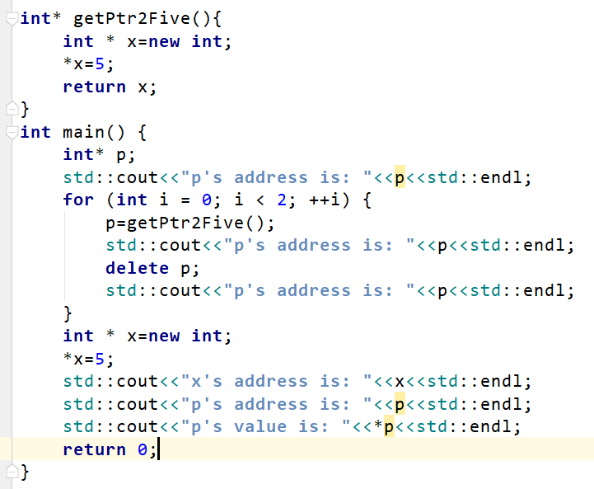
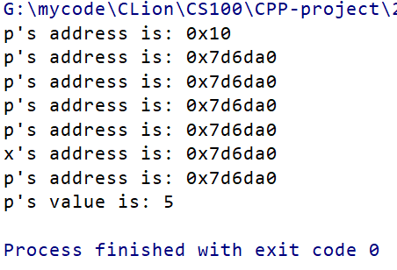

Slide 7
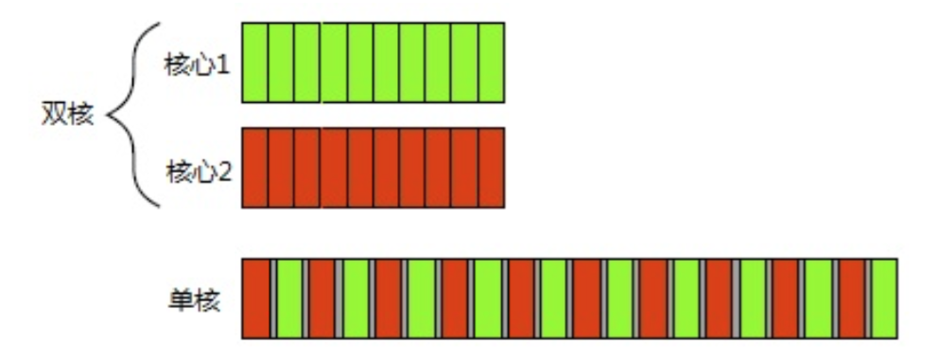
上下文切换

Slide 8
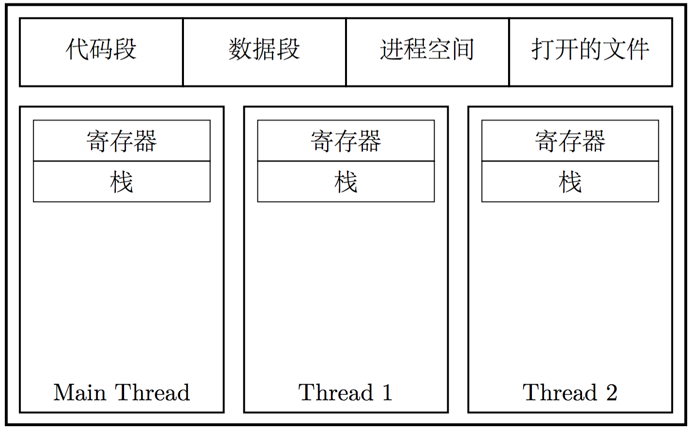

Slide 9
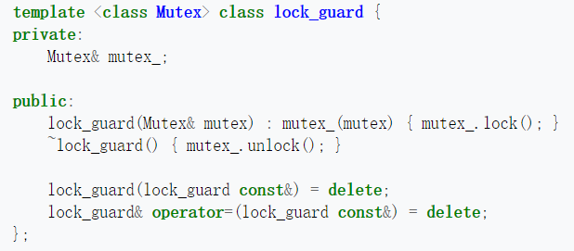
RAII: resource acquisition is initialization

Slide 10
#include <iostream> #include <string> #include <unordered_map> #include <map> using namespace std; struct Person { string name; int age; Person(string name_, int age_):name(name_), age(age_) {} bool operator==(const Person& p) const { return (this->age == p.age && this->name == p.name); } }; namespace std { template <> struct hash<Person> { size_t operator()(const Person &p) const { return hash<string>()(p.name) ^ hash<int>()(p.age); } }; } int main() { unordered_map<Person, string> myUnMap; myUnMap.emplace(Person("zoe", 23), "whuer"); return 0; }
#include <iostream> #include <string> #include <unordered_map> #include <map> using namespace std; struct Person { string name; int age; Person(string name_, int age_):name(name_) , age(age_) {} bool operator==(const Person& p) const { return (this->age == p.age && this->name == p.name); } }; struct hashGenerator { size_t operator()(const Person& p) const { return hash<string>()(p.name) ^ hash<int>()(p.age); } }; int main() { unordered_map<Person, string, hashGenerator> uno_map; uno_map.emplace(Person("zoe", 23), "whuer"); return 0; }

Slide 11
#include <iostream> #include <string> #include <unordered_map> #include <map> using namespace std; struct Person { string name; int age; Person(string name_, int age_):name(name_) , age(age_) {} }; struct hashGenerator { size_t operator()(const Person& p) const { return hash<string>()(p.name) ^ hash<int>()(p.age); } }; struct personCmp { bool operator()(const Person& p,const Person& q) const { return (p.age == q.age && p.name == q.name); } }; int main() { unordered_map<Person, string, hashGenerator, personCmp> uno_map; uno_map.emplace(Person("zoe", 23), "whuer"); return 0; }

Slide 12
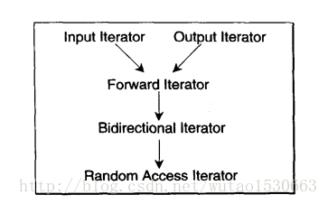

Slide 13
